Slide 1
APPetit
Android food delivery APP
Mobile Application Development
Group 14
Davide Gallotti
Federico Gianno
Marco Longo
Carlo Negri

Slide 2
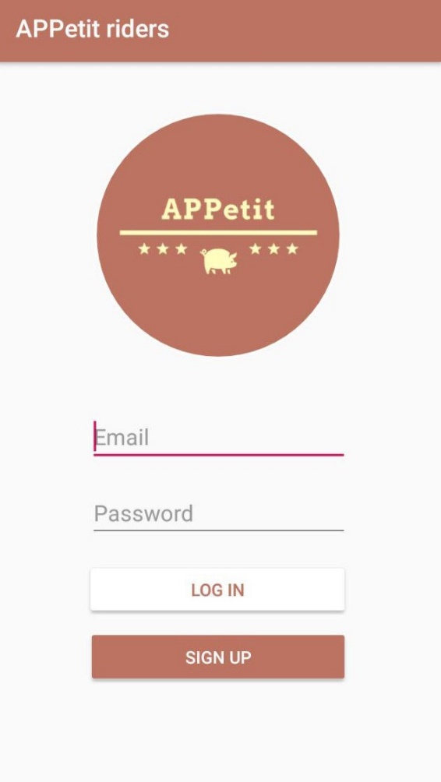
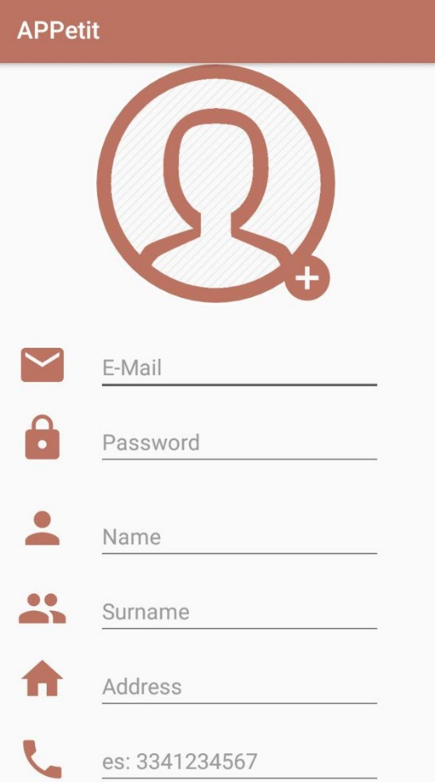
Login and Sign Up
APPetit is an android app to manage all the food delivering process.
The app is designed for 3 different users:
Customer
Restaurateur
Riders
Each of them needs to sign up by filling the displayed form.
When the confirm button is pressed, the account info are saved into Firebase Authentication Database.

Slide 3
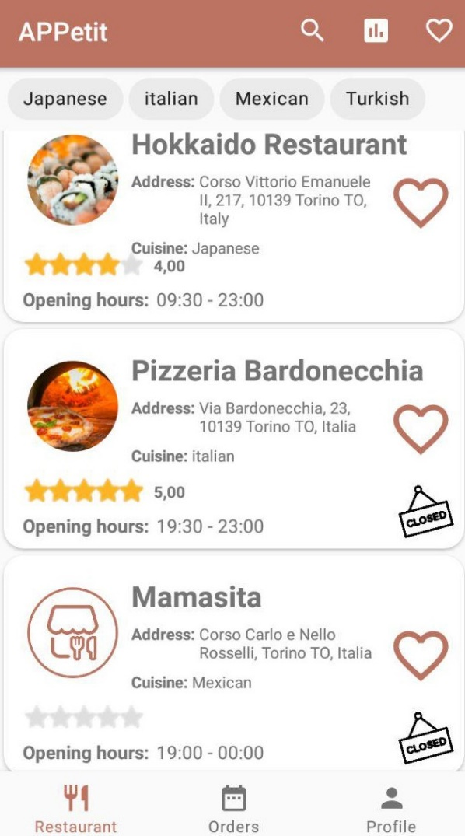
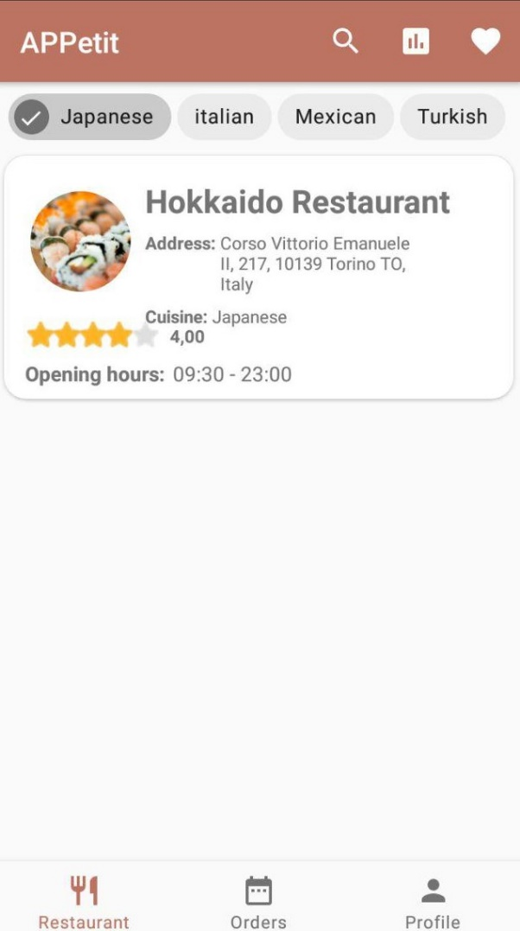
Customer
How it works:
Restaurants list is shown and it is based on the Firebase RecyclerView; Data are retrieved from database by means of a query.
1
2
The user can select a filter criteria for research based on Favourites, Cuisine or Review Rank.
3
It is not allowed to order in a closed Restaurant.

Slide 4
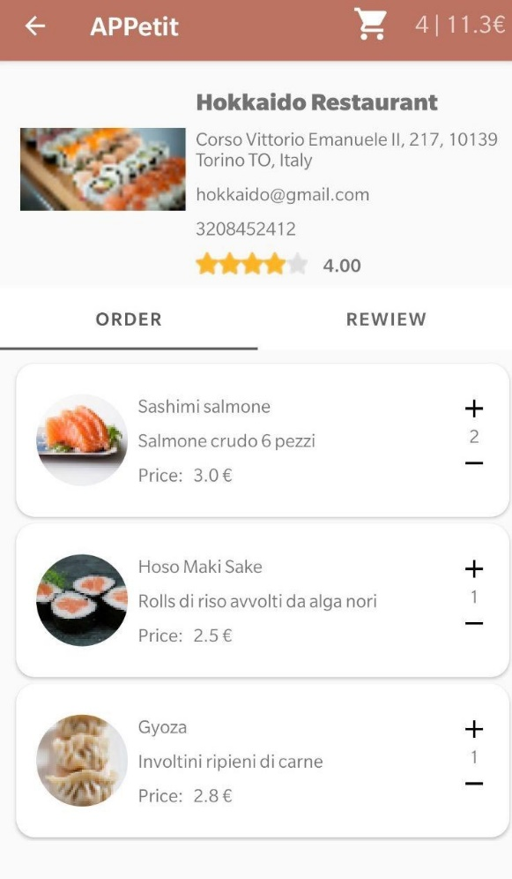
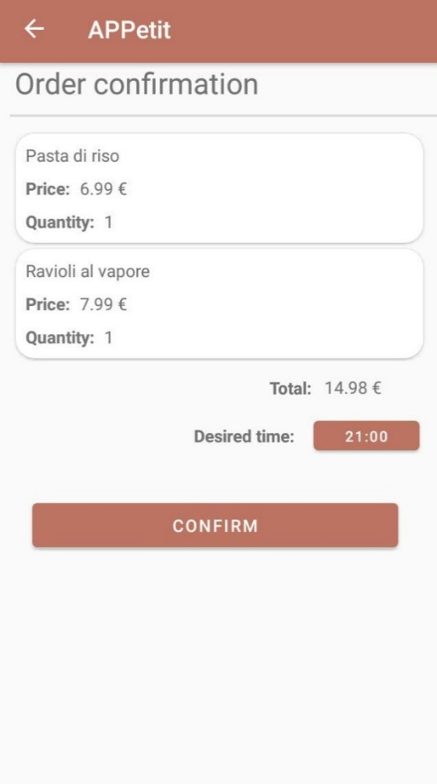
Making an order
Once selected a restaurant, it is possible to view its menu and its reviews.
The user can select desired quantity of dishes to be ordered and then confirm it selecting the delivering time.
The ‘order’ and ‘review’ fragments are managed by means of a Page Adapter.
Once the order is confirmed, a related data structure is saved into Firebase Database.

Slide 5
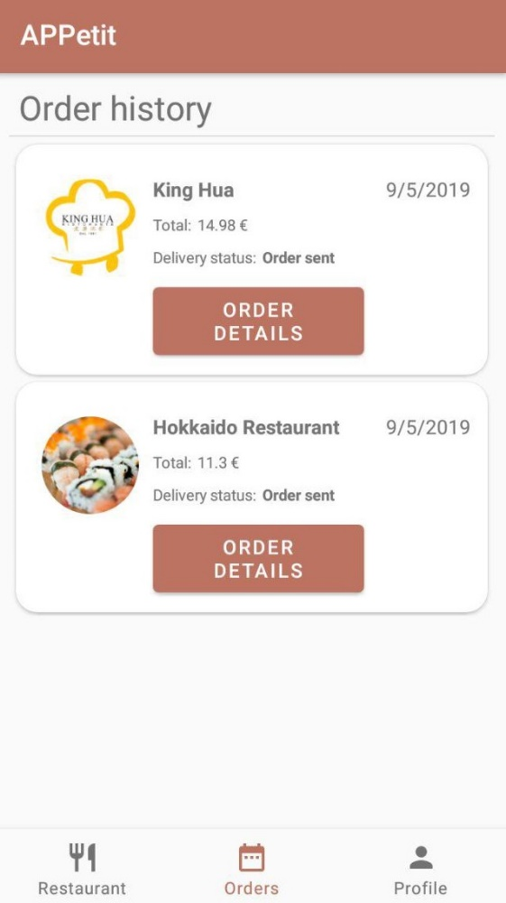
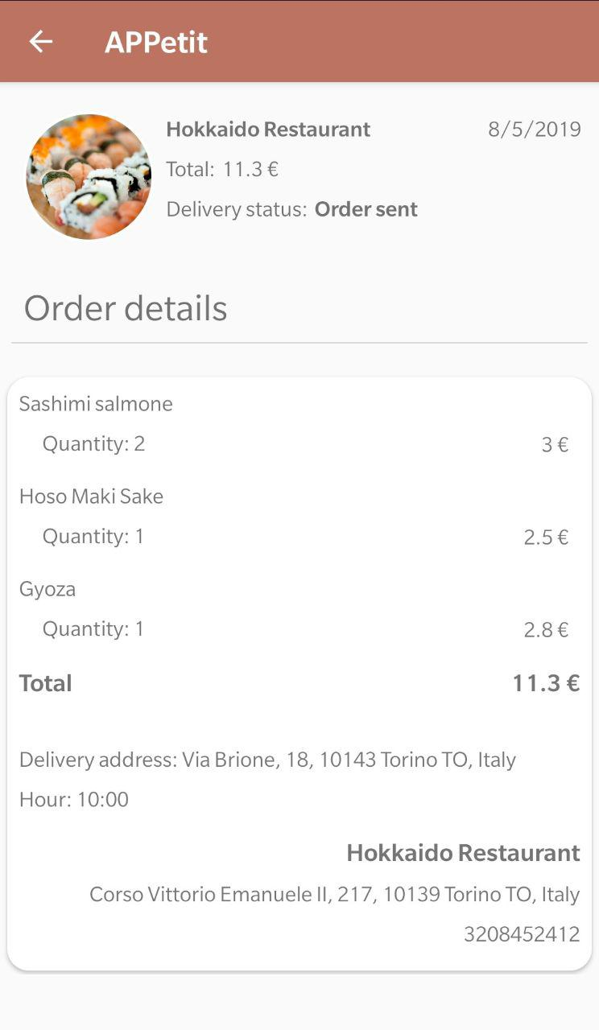
Order History
An order history is available on customer app such that the user can check details of each order and review it once it is delivered.
The user can also keep track of his order by checking the status:
Order Sent
Order Refused
Delivering
Order Delivered

Slide 6
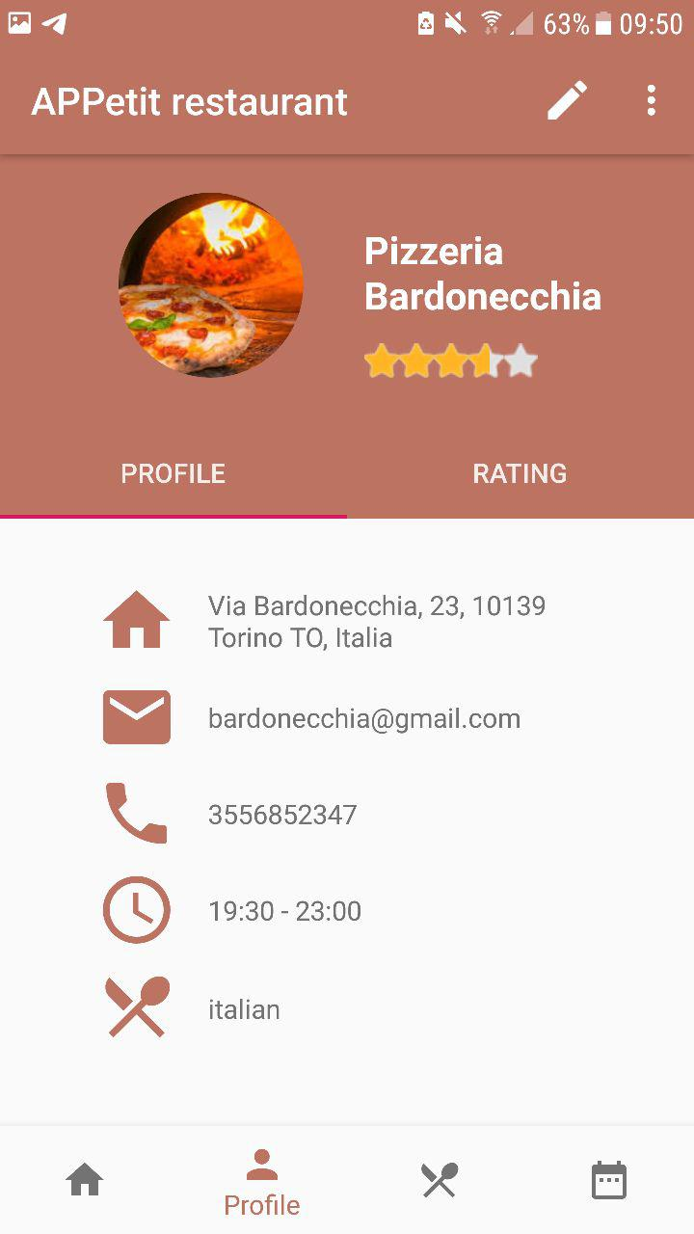
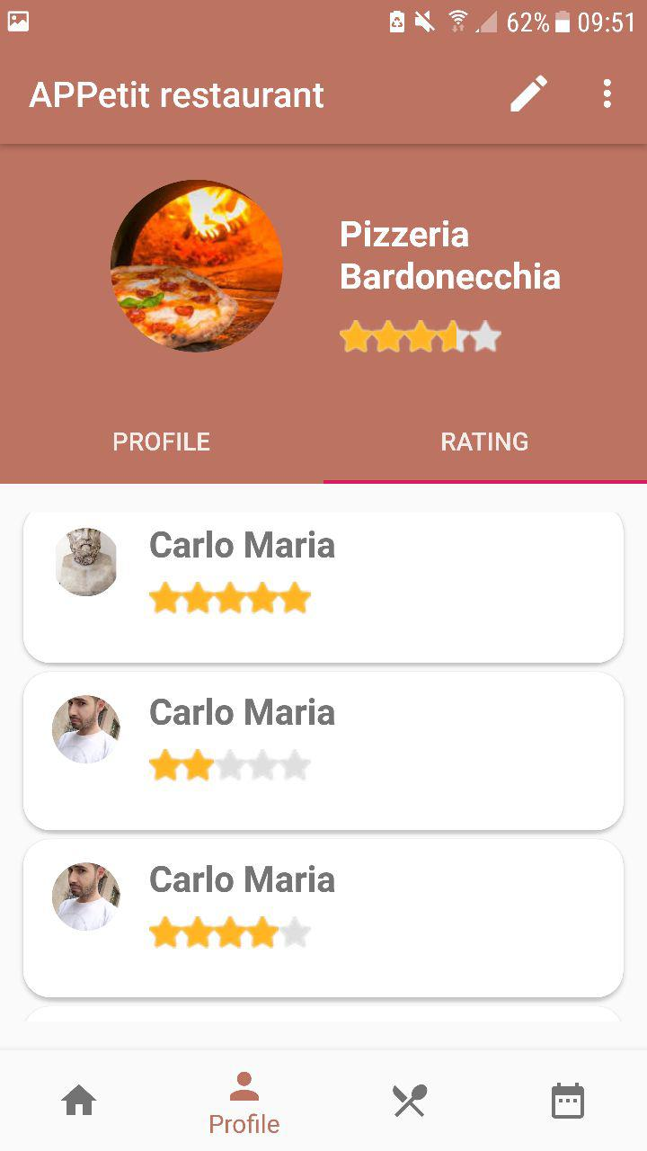
Restaurant
The restaurateur profile shows all the information inserted during the registration phase. Data can be modified by clicking on the OptionsMenu.
The Profile Fragment includes also a rating section which includes all the reviews given by the customers.

Slide 7
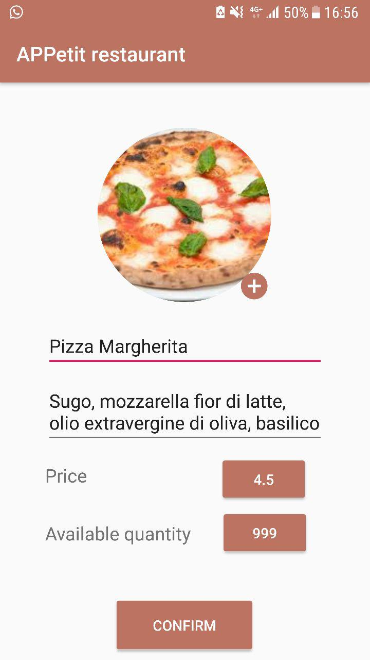
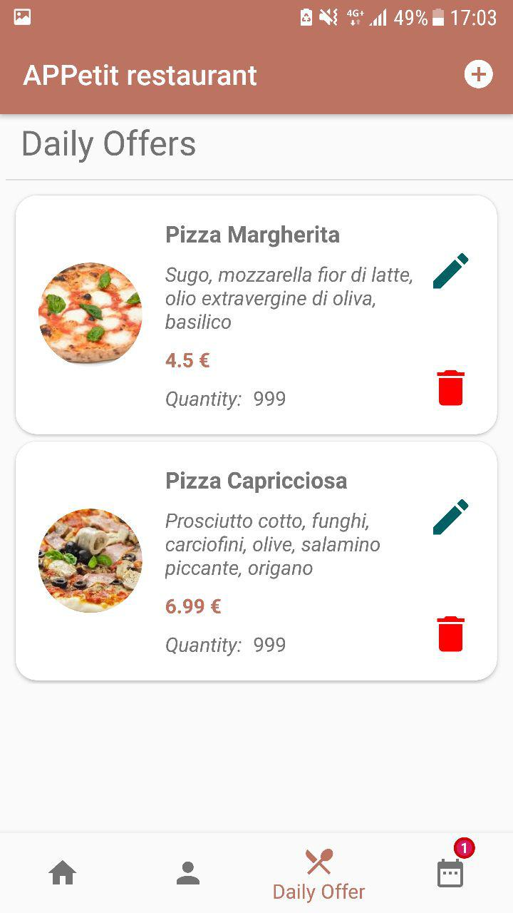
Adding new item to Daily Offer menu
Adding operation is done on a dedicated Activity where the user inserts all the info related to the dish. Once the confirm button is pressed the new item is binded with ReclyclerView which shows all menu offers.
Every item can be updated or removed from the list by means of two dedicated buttons.

Slide 8
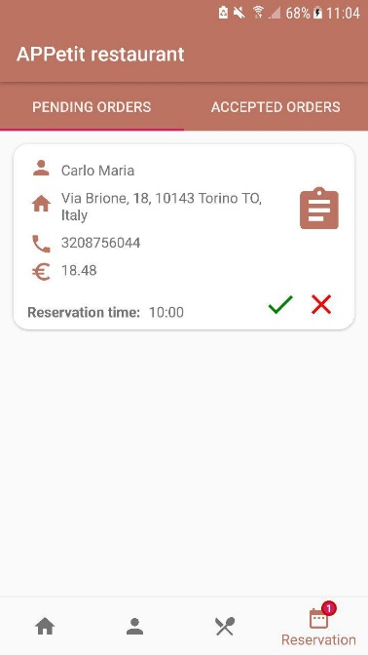
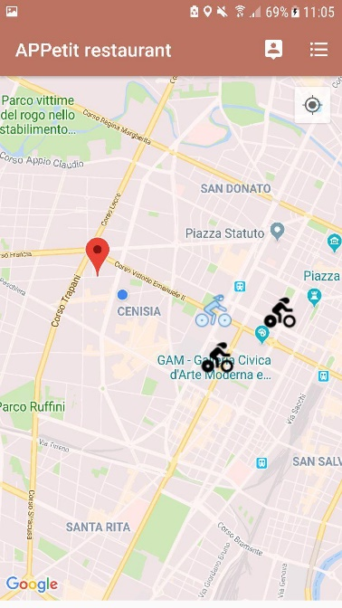
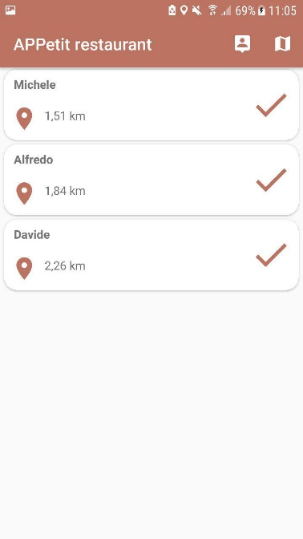
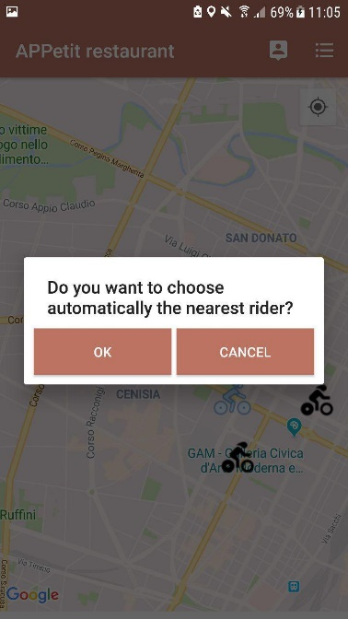
Order Lifecycle
1
Restaurateur receives order by means of notification on the BottomNavigationMenu
2
The user can himself select the rider on the map.
3
In alternative way by a list of riders or choosing automatically the nearest one

Slide 9
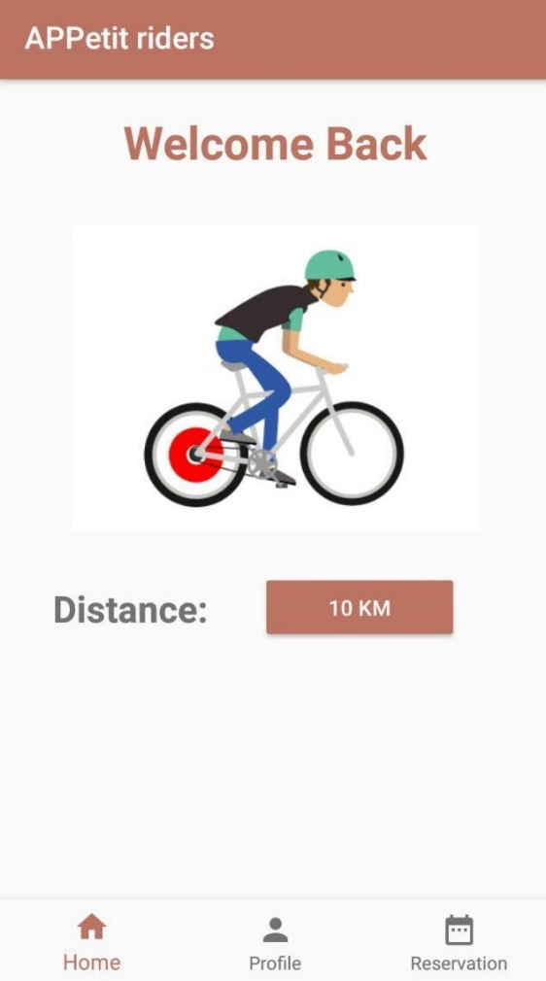
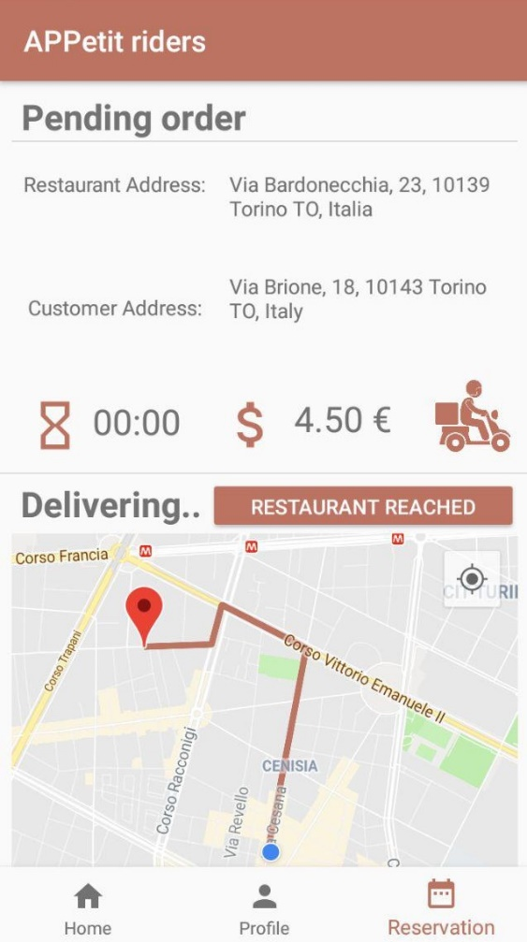
Rider delivering
When an order is assigned to a rider, a notification is shown on his app.
In the Reversation Fragment the rider can see the Restaurant and Customer address.
The path is shown on the map. Moreover, it is updated when the rider reaches the restaurant and the customer’s path is displayed.
When the order is delivered, the rider notifies it by clicking on the related button.

Slide 10
THANKS FOR ATTENTION

